Slide 1

Acropolis Institute of Technology & Research, Indore
www.acropolis.in

Slide 2
AutoValuator: Car Price Prediction Model
Submitted to: Department of Computer Science and Engineering

Slide 3

Team Members 1. PRIYANSHI GOYAL
2. RACHIT SHIVHARE RAHUL SHARMA PRANAY JAIN
Supervised by:
Prof. Krupi Saraf
3.
4.

Slide 4
Project Presentation Outline
Introduction
Problem Statement
Survey of Existing Systems
Project Objectives
Requirement Analysis
Solution Proposed
Features
System architecture
User Interface
Testing Plan
The Outcome Discussion
Conclusions

Slide 5
Introduction
Our solution, AutoValuator, is a smart web platform that automates the evaluation process for cars using a simple form-based system.
It collects user input (like car model, year, mileage, fuel type, etc.) and provides instant evaluation results.
The platform simplifies decision-making by generating downloadable reports and performance summaries.
It saves users time, removes guesswork, and improves accuracy by centralizing car evaluation in one place.
Accessible from any device, AutoValuator is built to assist car buyers, sellers, and evaluators with an easy-to-use, reliable system.

Slide 6
The Problem Statement
The Problem:
Users often struggle to determine the fair value of used cars manually.
They have to browse multiple car listing websites or consult experts to get an estimate.
The Solution:
AutoValuator offers a one-stop platform for automatic car evaluation.
The platform removes the need to switch between sites or rely on guesswork.
Users save time and avoid switching between websites.

Slide 7
Survey of Existing Systems
1. Second-hand car price prediction based on Multiple Linear Regression and
Random Forest
Author: Jiaying Gao
ML Techniques Used: Multiple Linear Regression (MLR), Random Forest (RF)
Dataset: Kaggle dataset (updated by Milan Vaddoriya)
Overview:
Compares Multiple Linear Regression and Random Forest for car price prediction.
MLR struggles with non-linearity, making it less effective for real-world applications.
Random Forest performs better due to its ability to handle complex relationships.
Highlights importance of feature selection and choosing the right model.

Slide 8
Survey of Existing Systems
2. Predicting the price of used cars using machine learning-based regression
models
Authors: G. SelvaKumar, S. Sruthi, M. Surya, A. Tamilselvi, R. Kavya
ML Techniques Used: Linear Regression, Decision Tree, Random Forest, XGBoost
Dataset: Cardekho Used Car dataset from Kaggle
Overview
Evaluates multiple regression models for used car price prediction.
Preprocessing steps include data cleaning, feature selection, and outlier removal.
XGBoost outperforms other models due to its ability to handle non-linear relationships.
Emphasizes importance of selecting the right regression model for accuracy.

Slide 9
Survey of Existing Systems
3. Vehicle Price Prediction System using Machine Learning Techniques
Authors: Kafeel Noor, Shahbaz Jan
ML Techniques Used: Multiple Linear Regression
Dataset: Data collected from PakWheels.com (Pakistan's largest used car website)
Overview
Uses Multiple Linear Regression to predict car prices with 98% accuracy.
Data scraped from PakWheels.com and preprocessed to remove duplicates.
MLR performs well with a structured dataset but may not generalize across regions.
Highlights that MLR can be highly accurate in specific market conditions.

Slide 10
Survey of Existing Systems
4. Prediction of Used Car Prices Using Machine Learning Techniques Based on
Vehicle Characteristics and Details
Authors: Enis Gegic, Becir Isakovic, Dino Keco, Darko Kreso, Dijana Asceric
ML Techniques Used: Support Vector Machine (SVM), Random Forest (RF), Artificial Neural Network (ANN)
Dataset: Scraped from www.autopijaca.ba (Bosnian car marketplace)
Overview
Compares SVM, Random Forest, and ANN for car price prediction.
Dataset was scraped and preprocessed for consistency.
Random Forest performed best due to handling high-dimensional data.
ANN showed potential but required high computational resources.
Suggests Random Forest as a reliable model for real-world applications.

Slide 11
Survey of Existing Systems
5. Used Cars Price Prediction using Supervised Learning Techniques
Authors: V Pattabiraman, M Ganesh
ML Techniques Used: Linear Regression, K-Nearest Neighbors (KNN), Support Vector Machine (SVM), Random Forest (RF)
Dataset: Kaggle dataset (strongly implied)
Overview
Examines different supervised learning models for used car price prediction.
Preprocessing included handling missing values, scaling, and feature selection.
Random Forest achieved the highest accuracy among tested models.
KNN performed well but required extensive fine-tuning.
SVM was effective but computationally expensive.
Random Forest emerged as the best-performing model for practical use.

Slide 12
Objectives
Build a smart platform that can predict the price of a car based on user input.
Help users know the estimated market value of used cars easily.
Use machine learning to make accurate and quick predictions.
Allow users to input car details like brand, model, year, fuel type, and kilometers driven.
Make car buying and selling decisions easier and more informed.

Slide 13
Requirement Analysis
Functional Specifications:
User Input: Users can enter car details like brand, model, year, fuel type, etc.
Input Validation: System checks if all required fields are filled correctly.
Price Prediction: Predicts the estimated car price using a trained ML model.
Result Display: Shows the predicted price clearly on the screen.
Downloadable Reports: Displays reports of estimated price and downloads it for user.

Slide 14
Non-Functional Specifications: 1. Performance: System gives results within a few seconds. 2. Usability: Interface is clean, responsive, and easy to use. 3. Compatibility: Works on both desktop and mobile browsers. 4. Accuracy: Provides reliable and accurate predictions. 5. Scalability: Can handle larger datasets in future updates.
Requirement Analysis

Slide 15
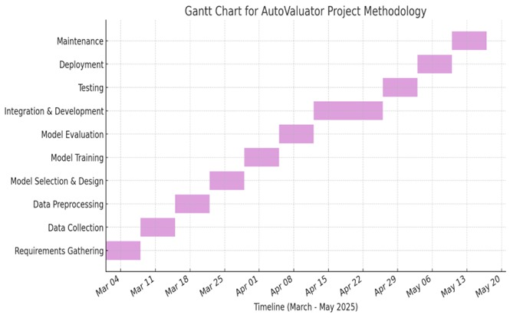
Solution Proposed
AutoValuator acts as a Car Price Predictor which predicts the selling price of car.
Methodology includes:
Data Collection
Data Preprocessing
Feature Selection
Data Splitting
Model Building
Model Evaluation
Visualization

Slide 16
Features
Form-Based Car Data Entry:
Users can enter car details such as brand, model, year, fuel type, transmission, and kilometers driven through a simple and intuitive form.
2.ML-Based Price Prediction:
The system uses trained Machine Learning models like Linear Regression or Random Forest to predict the estimated resale value of the car accurately.
3. Instant Report Generation:
After submitting the car details, users receive a detailed evaluation report including estimated price, model info, and confidence range
4. Data-Driven Decision Support:
The platform helps users make informed decisions by evaluating current market trends, historical data, and similar car listings.
5. Simple & User-Friendly Interface: Designed with a clean and intuitive layout, users can smoothly navigate through the evaluation process without any technical hassle.

Slide 17
System Architecture
The system architecture of this project is made up of two main parts that work together to make the platform run smoothly:
Frontend (User Interface):
This is what users see and interact with. It allows them to enter car details such as brand, model, year, fuel , type, transmission, and kilometers driven through a clean and simple form.
This is built using ReactJS and CSS.
2. Backend (Processing Engine):
This part takes the user input, runs it through a trained Machine Learning model, and returns the estimated price of the car.
Developed using Python, the backend receives car details, loads the trained ML model (like Decision Regression or Random Forest), performs the prediction, and sends the result back to the frontend.

Slide 18
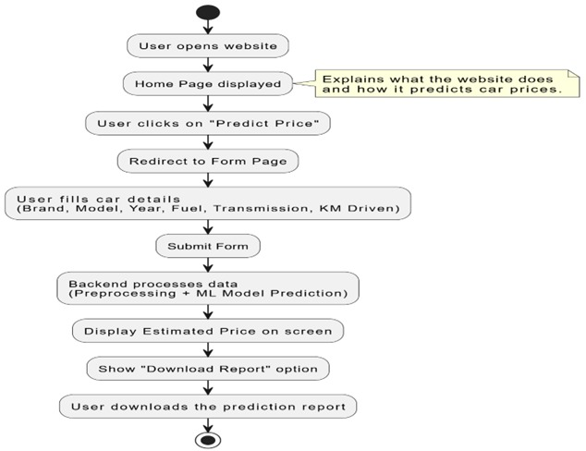
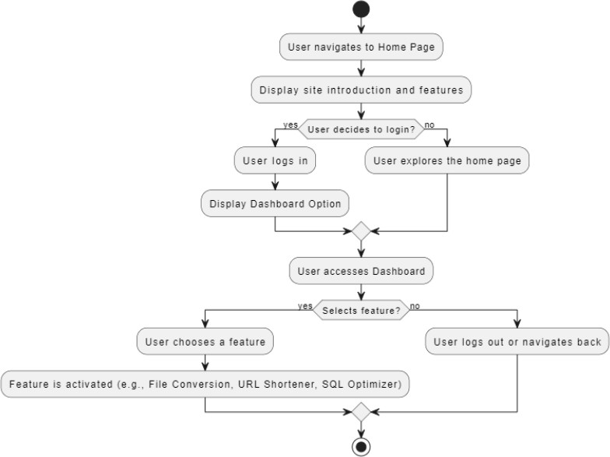
How They Work Together: 1. User Input: The user submits car details via the frontend form. 2. Backend Prediction: The backend processes this input using the ML model and calculates the car’s estimated selling price. 3. Response: The frontend displays the predicted price instantly to the user in a report format
System Architecture

Slide 19
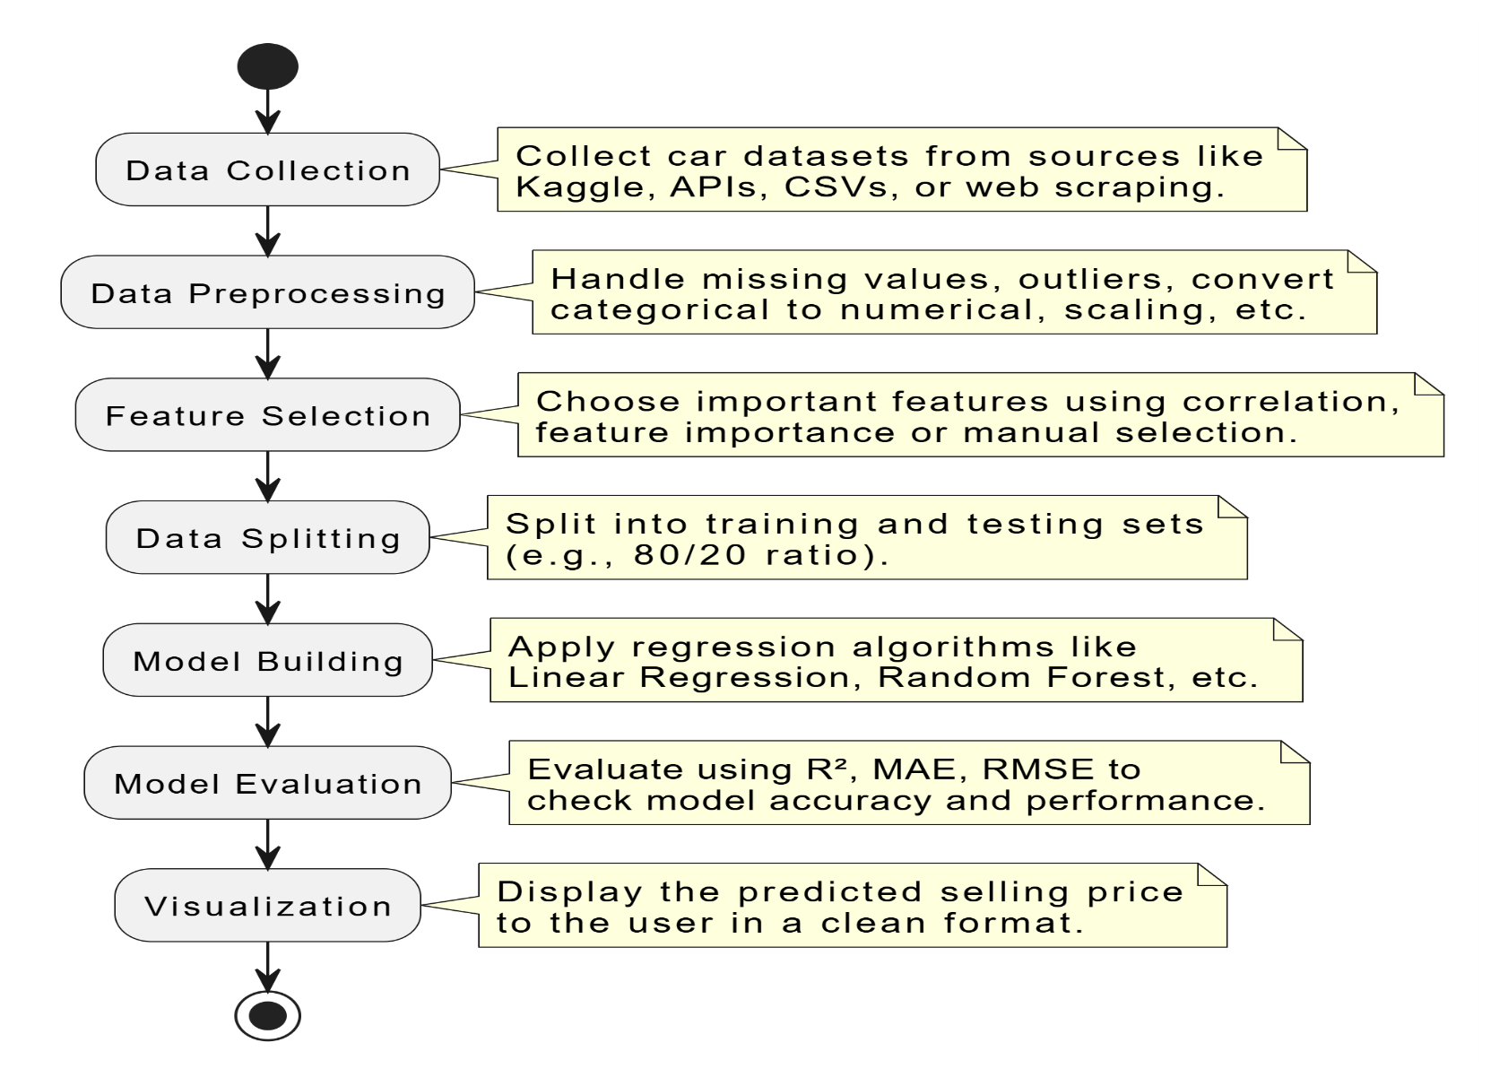
System Architecture
The Backend Processing involves following steps:
Data Collection
Data Preprocessing
Feature Selection
Data Splitting
Model Building
Model Evaluation
Visualization

Slide 20
User Interface
The User Interface (UI) of the AutoValuator platform is designed to be intuitive and beginner-friendly, ensuring users can easily predict their car’s price without any confusion or complexity.
Homepage:
· The homepage welcomes users with a clean, minimal layout.
· A prominent "Estimate Now" button is placed at the center to grab attention and guide users directly to the main feature.
· A simple top navigation bar allows users to navigate easily across the platform if needed.
2. Predict Price :
This page includes a form-based interface where users can fill in essential car details like:
Brand, Model, Year
Fuel Type, Transmission
KMs Driven, Ownership
Each field has a dropdown or input box with hints, making it easier even for non-technical users.
A “Get Estimated Price” button is shown at the bottom to submit the form.
3. Report Page (After Prediction):
Once the price is predicted using the ML model, users are taken to a new page showing the estimated car price.
A neat, card-style layout displays:
User’s input summary
Predicted price
A "Download Your Report" button allows users to save a PDF version of their car valuation.

Slide 21
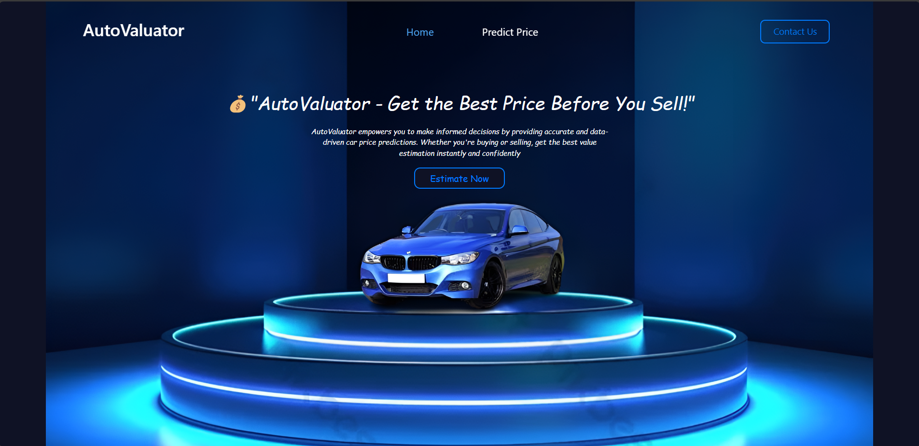
User Interface

Slide 22
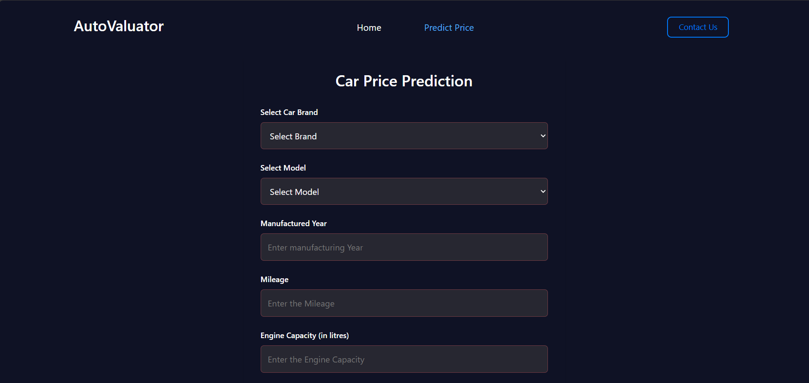
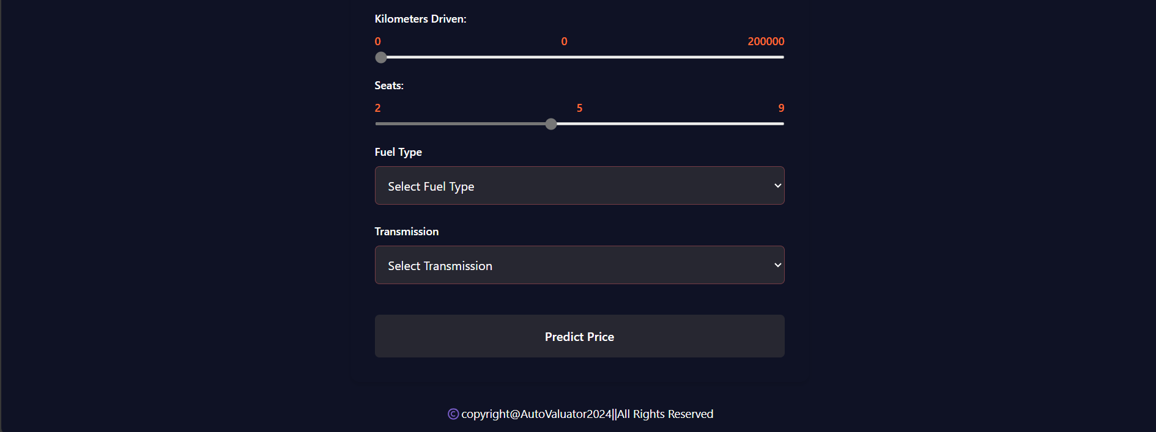
User Interface

Slide 23
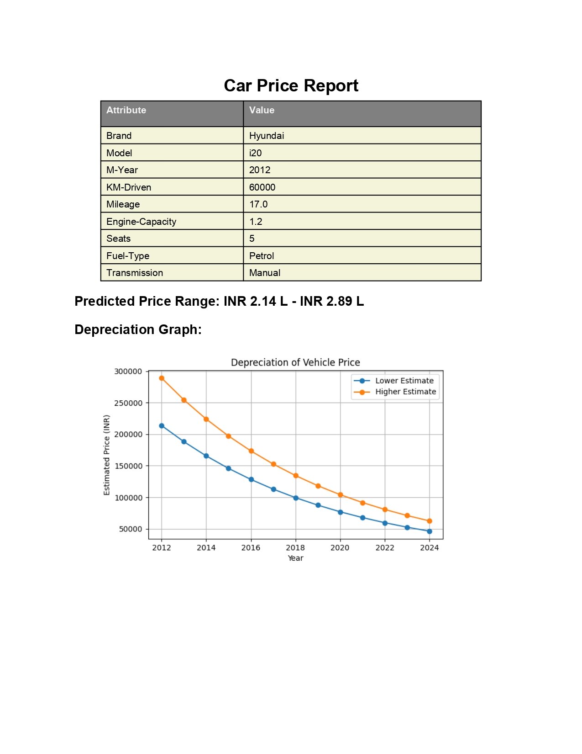
User Interface

Slide 24
Testing Plans
1. Unit Testing:
We will test individual components of the project separately — such as the form input fields, price prediction logic, and the ML model.
2. Integration Testing:
We’ll check how different parts of the system work together — for example, whether user inputs from the frontend are correctly
sent to the backend and whether the predicted price is properly shown on the frontend.
3. User Testing:
Real users will test the platform by entering car details and predicting prices to see if the UI is intuitive and the results are understandable.
4. Performance Testing:
We’ll test the platform's speed and responsiveness when multiple users use it simultaneously or when complex data is entered.
5. Security Testing: We'll test for secure data handling — especially ensuring that the user inputs are protected from common threats like injection attacks or data breaches. 6. Bug Fixing and Retesting:
After discovering any bugs, we’ll fix them and retest the full workflow — from user input to report download — to make sure everything works correctly.

Slide 25
The Outcome
Smart Price Prediction Tool
Streamlined User Experience
Improved Decision-Making
User-Friendly Web Interface
Fast & Efficient Backend
Report Download Feature
Data Privacy Focused

Slide 26
Conclusion
Helps users make informed decisions.
The project aims to make car price prediction simple and effective.
Predicts price based on user inputs like brand, model, fuel type, etc.
Offers a clean and user-friendly interface.
Uses machine learning on the backend.
Provides estimated price in just a few steps.
Helps User to make informed decisions.
Make the car-selling process faster , smarter and more convenient.

Slide 27
Q&A

Slide 28
THANKS

